Slide 1

Pythagoras’ Theorem
Quick revision
Click here to listen to the audio

Slide 2

Pythagoras’ Theorem
C must be the hypotenuse, a and b can swap around.
It doesn’t matter which is which.
Hypotenuse
The hypotenuse is the longest side and it is opposite
the right angle, a and b make the right angle.
c
b
a
$$a^{2}+b^{2}=c^{2}$$
Click here
for audio

Slide 3



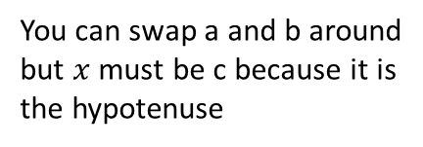




Finding the hypotenuse
You can swap a and b around
but $x$ must be c because it is
the hypotenuse
Find side length $x$.
Label the triangle
b
c
$$x$$
$$x$$
34cm
34cm
a
21cm
$$a^{2}+b^{2}=c^{2}$$
21cm
$${21}^{2}+{34}^{2}=c^{2}$$
$$c^{2}=1597$$
Now square root
Click here
for audio
$$x=40.0 cm$$

Slide 4

Finding the side other than the hypotenuse
Find side length $x$.
You can swap a and b around
but $the 59cm side must be$
c because it is the hypotenuse
$$x$$
32cm
$$x$$
32cm
Label the triangle
c
59cm
59cm
a
b
$$a^{2}+b^{2}=c^{2}$$
$${32}^{2}+b^{2}={59}^{2}$$
Now take ${32}^{2}$
$$b^{2}={59}^{2}−{32}^{2}$$
Click here
for audio
$$b^{2}=2457$$
Now square root
$$x=49.6 cm$$

Slide 5








Problem involving an isosceles triangle
Find the perpendicular height of the isosceles triangle shown below.
Click here
for audio
$$a^{2}+b^{2}=c^{2}$$
Perpendicular
height
$${42}^{2}+b^{2}={110}^{2}$$
Now take ${42}^{2}$
110cm
110cm
$$x$$
110cm
$$b^{2}={110}^{2}−{42}^{2}$$
$$x$$
c
b
$$b^{2}=10336$$
Now square root
a
$$x=101.7 cm$$
84cm
42cm
42cm
Isosceles triangles are symmetrical
so the base of the blue right angled
triangle is half of 84cm so 42cm
The perpendicular height is 101.7cm

