Slide 1

Trigonometry
Finding the side which is the numerator of the fraction
Click here to listen to audio

Slide 2
First you need to check your calculator is set to degrees
Look at the top of the calculator display, you should see a . If so all is fine.
If you don’t, you’ll see either an or a . You need to see for degrees.
Here are some instructions to get your calculator onto degrees.
D
R
G
D
Press the following buttons on your calculator
Click here
for audio
Shift
Menu setup
1 : Input/Output
You will see 2 : Angle Unit. Press
2
You will see 1 : Degree Press
1
3 : Number Format
2 : Radian
4 : Engineer Symbol
3 : Gradian
Now you should see a at the top of your calculator display
D

Slide 3







The Sine, Cosine and Tangent ratios (Sin, Cos and Tan)
H
This just summarises
the triangle and
Sin, Cos and Tan.
O
This explains what is meant
by finding the numerator.
Important you listen to this.
$$θ$$
A
$$Sinθ=\frac{Opposite}{Hypotenuse}$$
$$Cosθ=\frac{Adjacent}{Hypotenuse}$$
$$Tanθ=\frac{Opposite}{Adjacent}$$
$$Sinθ=\frac{O}{H}$$
$$Cosθ=\frac{A}{H}$$
$$Tanθ=\frac{O}{A}$$

Slide 4









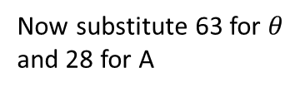

Find the side length $x.$
Write out SOH CAH TOA and tick off the side
we know and the one we are trying to find. So
here, O and A.
SOH CAH TOA
H
O
$$x$$
$$x$$
We want the one that has O and A
So we are going to use Tangent
63
63
$$Tanθ=\frac{O}{A}$$
Now substitute 63 for $θ$
and 28 for A
A
28cm
28cm
$$Tan63=\frac{O}{28}$$
Now multiply by 28
Click here
for audio
now type
$$O=28×Tan63$$
Now type this into
Your calculator
2
8
$$×$$
3
$$×$$
Tan
6
858
$$=$$
$$x=55.0 cm$$

Slide 5
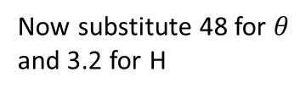








Write out SOH CAH TOA and tick off
and the side we know and the side we
are trying to find. So here, A and H.
Find the length of side PQ
3.2cm
3.2cm
H
P
R
R
P
48
48
SOH CAH TOA
$$x$$
O
A
We want the one that has A and H
So we are going to use Cosine
Q
Q
$$Cosθ=\frac{A}{H}$$
Now substitute 48 for $θ$
and 3.2 for H
Click here
for audio
$$Cos48=\frac{A}{3.2}$$
Now multiply by 3.2
now type
$$A=3.2×Cos48$$
Now type this into
Your calculator
3
.
2
$$×$$
Cos
4
8
$$=$$
$$x=2.1 cm$$
$$×$$

Slide 6

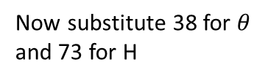





Find the length of side MK
Write out SOH CAH TOA and tick off
and the side we know and the side we
are trying to find. So here, O and H.
M
M
A
L
L
38
38
SOH CAH TOA
73cm
$$x$$
O
73cm
H
We want the one that has O and H
So we are going to use Sine
K
K
$$Sinθ=\frac{O}{H}$$
Now substitute 38 for $θ$
and 73 for H
$$Sin38=\frac{O}{73}$$
Now multiply by 73
Click here
for audio
now type
$$O=73×Sin38$$
Now type this into
Your calculator
7
3
$$×$$
Sin
4
8
$$=$$
$$x=44.9 cm$$
$$×$$

Slide 7


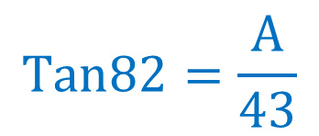
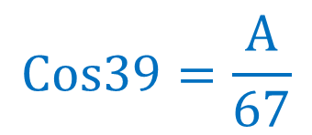

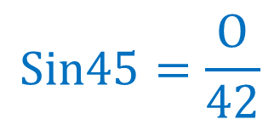
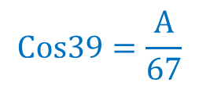
For these problems you will be finding
the side which is on top
$$Sin45=\frac{O}{42}$$
$$Cos39=\frac{A}{67}$$
$$Tan82=\frac{A}{43}$$
$$Cos39=\frac{A}{67}$$
$×$ by 67
For example
Click here
for audio
$$A=67×Cos39$$
$$A=52.1 cm$$

