Slide 1
Sine Rule and Cosine Rule
Choosing the correct rule

Slide 2
Summary of the two rules

Slide 3



Sine Rule
To find a side you need
To find an angle you need
The opposite angle
Another angle opposite side pair
The opposite side
Another angle opposite side pair
Click here
for audio
$$x$$
$$θ$$

Slide 4
Sine Rule
Finding a side
Finding an angle
Want to find a side
Want to find an angle
$$\frac{a}{SinA}=\frac{b}{SinB}$$
Need another angle
opposite side pair
$$\frac{SinA}{a}=\frac{SinB}{b}$$
Need another angle
opposite side pair
You need the
opposite angle
You need the
opposite side
Click here
for audio

Slide 5








Finding a side
Find side length$x$
C
76
Label the triangle
76
$$x$$
$$x$$
b
a
49
49
c
B
A
53cm
53cm
Use
$$\frac{a}{SinA}=\frac{c}{SinC}$$
$$C=76 c=53 A=49 we are finding a$$
$$\frac{a}{SinA}=\frac{b}{SinB}=\frac{c}{SinC}$$
$$\frac{a}{Sin49}=\frac{53}{Sin76}$$
Now multiply by Sin49
$$a=\frac{53}{Sin76}×Sin49$$
Now type this into your calculator
Equations are always easier to solve if what
you are trying to find is on top of the fraction.
This is why we use this one as the side is on
the top.
$$x=41.2 cm$$
Click here
for audio

Slide 6

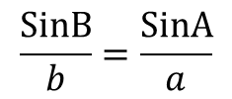






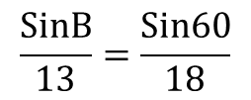
Finding an angle
C
b
a
13cm
13cm
18cm
18cm
Label the triangle
60
$$θ$$
60
$$θ$$
A
c
B
Now we are going to use
$$\frac{SinB}{b}=\frac{SinA}{a}$$
$$A=60 a=18 b=13 we are finding B$$
$$\frac{SinA}{a}=\frac{SinA}{b}=\frac{SinC}{c}$$
$$\frac{SinB}{13}=\frac{Sin60}{18}$$
Now $×$ by 13
Click here
for audio
Equations are always easier to solve if what
you are trying to find is on top of the fraction.
This is why we use this one as the angle is on
the top.
$$SinB=\frac{Sin60}{18}×13$$
$$SinB=0.6255$$
Now type shift
Sin
Ans
=
$$θ=38.7$$

Slide 7

Cosine Rule
To find a side you need
To find a side you need
The opposite angle
The other two sides
All three sides.
Click here
for audio
$$x$$
$$θ$$

Slide 8
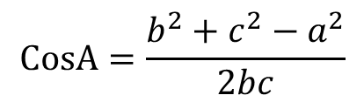

Cosine Rule
Finding a side
Finding an angle
You need the
opposite angle
Want to find a side
$$CosA=\frac{b^{2}+c^{2}−a^{2}}{2bc}$$
$$a^{2}=b^{2}+c^{2}−2bcCosA$$
You need all three sides
You need the
other two sides

Slide 9








Finding the length of a side
Label the triangle. I’m going to label the 42 angle A, that way will be a.
$$x$$
Find
$$x$$
B
c
$$x$$
16cm
a
$$x$$
16cm
42
C
b
42
21cm
A
21cm
We want a so use the formula
$$a^{2}=b^{2}+c^{2}−2bcCosA$$
$$a^{2}={21}^{2}+{16}^{2}−2×21×16×Cos42$$
$$a^{2}=197.6066773$$
Now square root
Click here
for audio
$$a=14.1 cm$$
$$x=14.1 cm$$

Slide 10





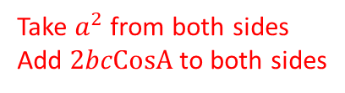

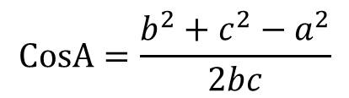
Finding an angle
$$a^{2}=b^{2}+c^{2}−2bcCosA$$
C
Now we are going to rearrange this equation to make CosA the subject.
$$−a^{2}$$
b
a
Take $a^{2}$ from both sides
Add $2bcCosA$ to both sides
$$a^{2}=b^{2}+c^{2}−2bcCosA$$
A
c
B
$$+2bcCosA$$
$$2bcCosA=b^{2}+c^{2}−a^{2}$$
Now divide by $2bc$
Click here
for audio
$$CosA=\frac{b^{2}+c^{2}−a^{2}}{2bc}$$
You need all three
sides to find an angle

Slide 11
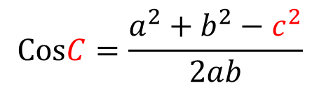
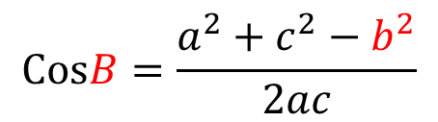
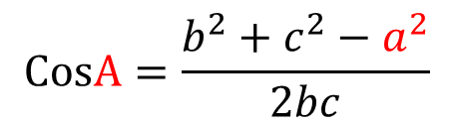
Finding an angle
The other two sides
which the angle is
between
The side opposite the
angle we are finding
$$CosB=\frac{a^{2}+c^{2}−b^{2}}{2ac}$$
$$CosA=\frac{b^{2}+c^{2}−a^{2}}{2bc}$$
$$CosC=\frac{a^{2}+b^{2}−c^{2}}{2ab}$$
The other
two sides
Click here
for audio

Slide 12


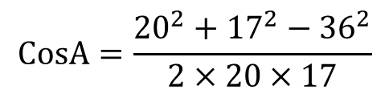
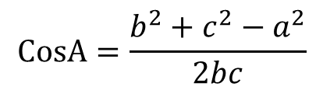

Find angle BAC
$$CosA=\frac{b^{2}+c^{2}−a^{2}}{2bc}$$
A
$$θ$$
20cm
$$CosA=\frac{{20}^{2}+{17}^{2}−{36}^{2}}{2×20×17}$$
17cm
b
c
C
a
$$CosA=−0.8926$$
Once you have -0.8926 on your
calculator then press
Shift
Cos
Ans
B
36cm
$$A=153.2$$
Click here
for audio
Don’t worry that CosA is negative 0.8926, it just means the angle is obtuse.

Slide 13
Sine Rule
To find a side you need
To find an angle you need
The opposite angle
Another angle opposite side pair
The opposite side
Another angle opposite side pair
Click here
for audio
$$x$$
$$θ$$

Slide 14
Cosine Rule
To find a side you need
To find a side you need
The opposite angle
The other two sides
All three sides.
Click here
for audio
$$x$$
$$θ$$

