Slide 1
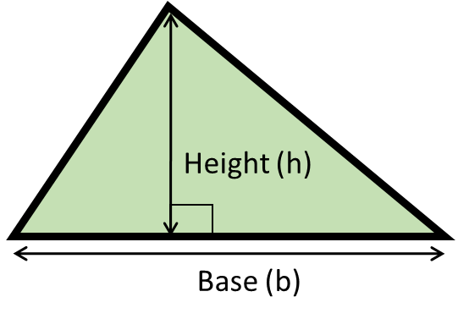
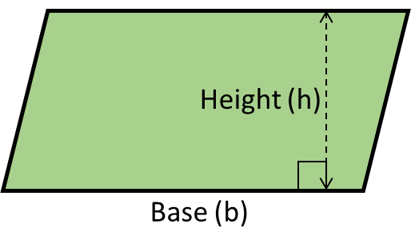
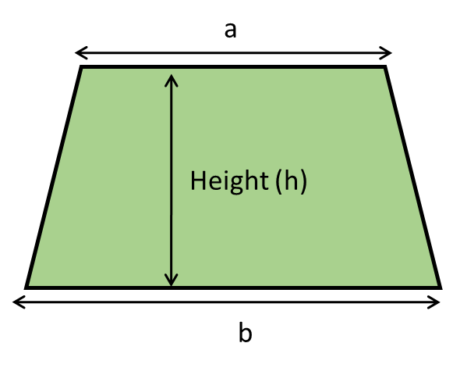
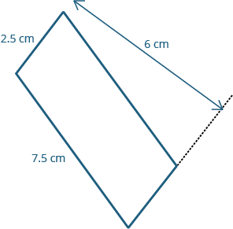
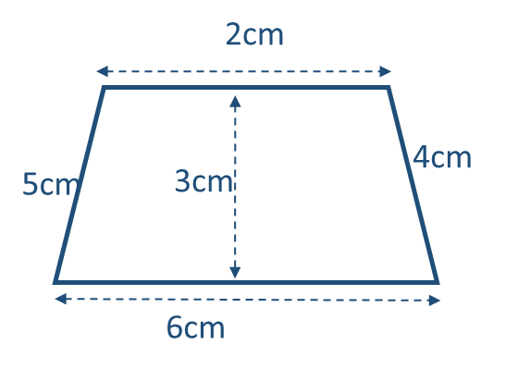
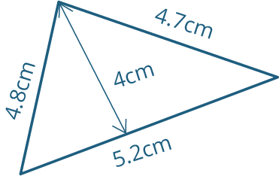
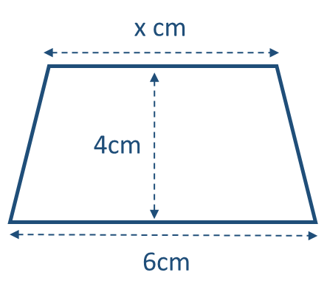
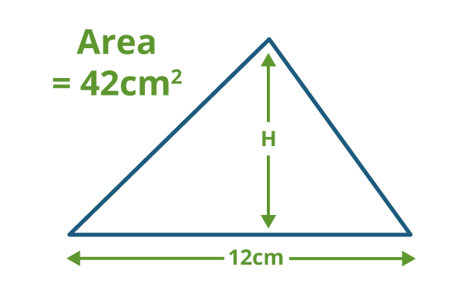
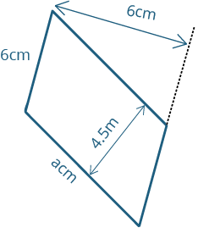
Year 7 Mathematics Knowledge Organiser – Perimeter, Area and Volume
KS4 Mathematics Knowledge Organiser – Percentages – Part 1
PERIMETER - the length of the boundary around a closed figure.
AREA - a measure of surface. Area is usually measured in square units e.g. square centimetres (cm²), square metres (m²).
FORMULA - an equation linking sets of physical variables. Plural: formulae.
PERPENDICULAR - at the right angle.
AREA OF TRIANGLES
Area = $\frac{1}{2}$ × base × perpendicular height
AREA OF PARALLELOGRAMS
Area = base × perpendicular height
AREA OF TRAPEZIUMS
Area = $\frac{1}{2}$ × (parallel sides added together) × height
Area = $\frac{1}{2}bh$ or $\frac{b×h}{2}$
Area = $bh$
Area = $\frac{1}{2}(a+b)h$ or $\frac{(a+b)h}{2}$
Example: Find area of this parallelogram.
Identify base and perpendicular height.
Write the formula, substitute and calculate the area.
Do not forget to use correct units.
Area = b × h
Area = 2.5 × 6
= 15 cm²
Example: Find area of this trapezium.
Identify parallel sides and perpendicular height.
Write the formula, substitute and calculate the area.
Do not forget to use correct units.
Area = $\frac{1}{2}(a+b)h$
Area = $\frac{1}{2}(6+2)×3$ = 12 cm²
Example: Find area of this triangle.
Identify base and perpendicular height.
Write the formula, substitute and calculate the area.
Do not forget to use correct units.
Area = $\frac{1}{2}bh$
Area = $\frac{1}{2}×5.2×4$ =
= 10.4 cm²
Example: Area of this trapezium is 15cm². Find x.
Multiply the area by 2.
Divide the answer by height to find (a + b).
Find the missing side.
Do not forget to use correct units.
Area = $\frac{1}{2}(a+b)h$
Area × 2 = (a + b) h
15 × 2 = (x + 6) × 4
30 = (x + 6) × 4
30 ÷ 4 = x + 6
7.5 = x + 6 x = 7.5 – 6 = 1.5 cm
Example: Area of this triangle is 42cm². Find the height.
Multiply the area by 2.
Divide the answer by base to find the height.
Do not forget to use correct units.
Area = $\frac{1}{2}bh$
Area × 2 = b × h
42 × 2 = 12 × h
84 = 12 × h
h = 84 ÷ 12 = 7 cm.
Example: Area of this parallelogram is 36cm². Find base a.
Divide the area by height which is perpendicular to the base a.
Do not forget to use correct units.
Area = b × h
Base = Area ÷ Height
Base a = 36 ÷ 4.5 = 8 cm.

Slide 2
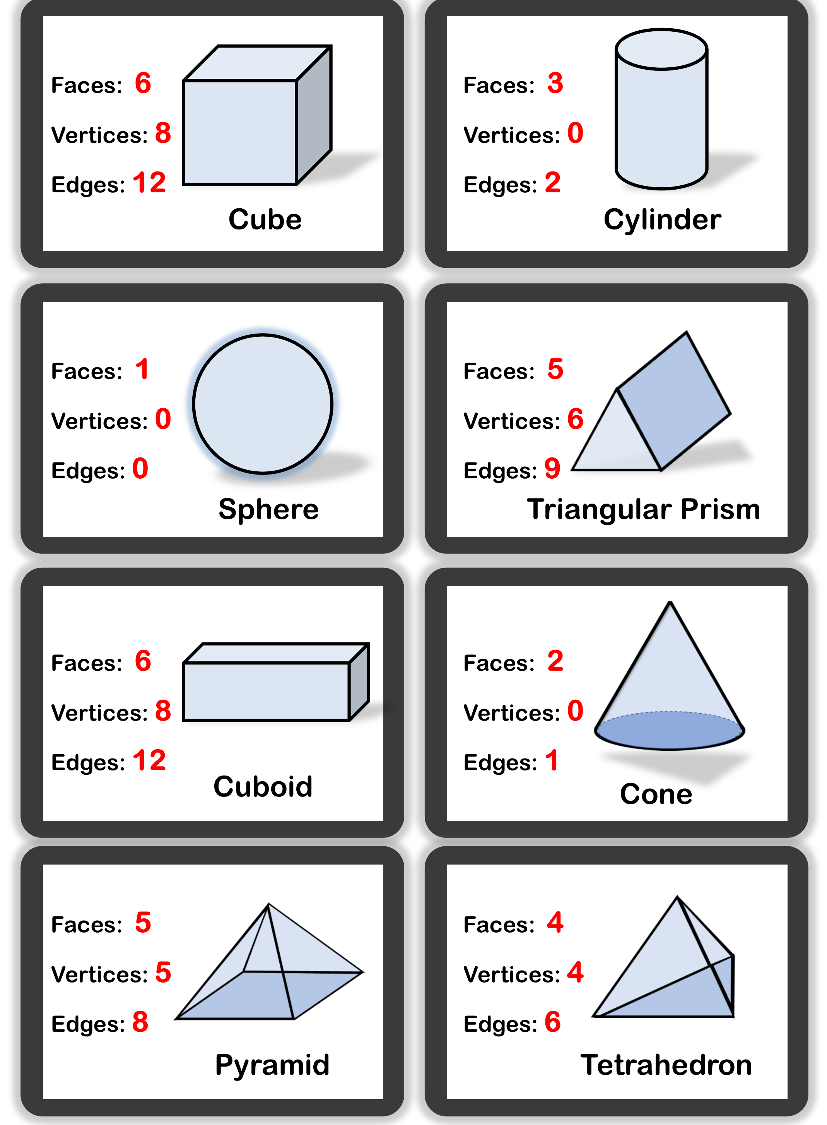
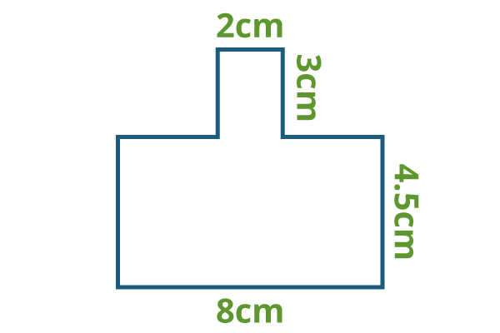
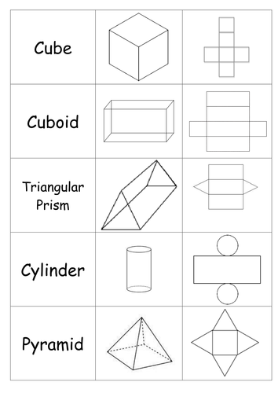
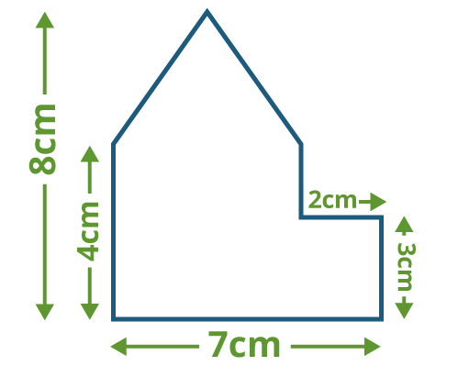
Year 7 Mathematics Knowledge Organiser – Perimeter, Area and Volume
KS4 Mathematics Knowledge Organiser – Percentages – Part 1
COMPOUND SHAPE is shape made up of two or more basic shapes.
GEOMETRY NET is a 2-dimensional shape that can be folded to form a 3-dimensional shape or a solid.
CUBOID is a 3D shape which has six rectangular faces at right angles to each other.
PERIMETER AND AREA OF COMPOUND SHAPES
PROPERTIES AND NETS OF 3D SHAPES
Example: Calculate the perimeter for this shape.
Find missing lengths and mark them on the diagram.
Add all lengths together.
Perimeter = 3 + 2 + 3 + 6 + 4.5 + 8 + 4.5 = 31 cm
3 cm
4.5 cm
Add up to 8-2 = 6 cm
Example: Calculate the area for this shape.
Divide compound shape into basic shapes.
Find areas of the basic shapes.
Add the areas together.
Total area = 10 + 20 + 6 = 36 cm²
4cm
Area of triangle = $\frac{1}{2}bh$ =
= $\frac{1}{2}×5×4$=
= 10 cm²
7–2 = 5cm
A
Area of rectangle A =
= b × h = 5 × 4 = 20 cm²
B
Area of rectangle B =
= b × h = 2 × 3 = 6 cm²

Slide 3
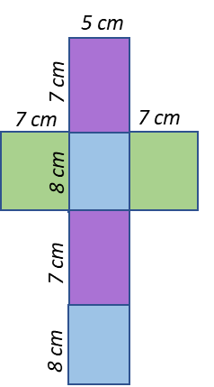
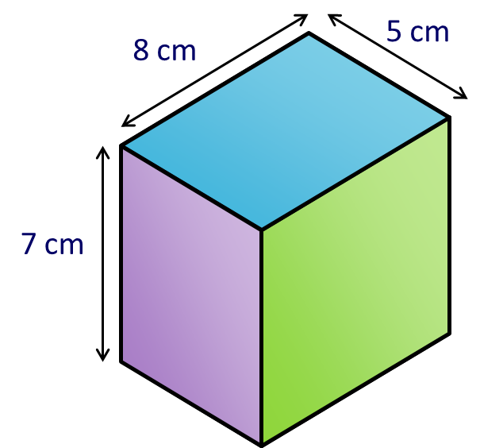
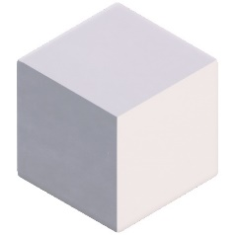
Year 7 Mathematics Knowledge Organiser – Perimeter, Area and Volume
KS4 Mathematics Knowledge Organiser – Percentages – Part 1
SURFACE AREA
To find the surface area of a shape, we calculate the total area of all of the faces.
Example: Find the surface area of this cuboid
VOLUME
Example: Find the volume of the same cuboid.
Volume = 7 × 8 × 5 = 280 cm³
The area of the top = 8 × 5 = 40 cm²
CAPACITY of a container is how much it can hold. The units are cm³, millilitres (ml) and litres (l).
1 ml = 1 cm³
1l = 1000 cm³
Example: Capacity of the cuboid above is
280 cm³ = 280 ml = 0.28 l.
The area of the front = 7 × 5 = 35 cm²
The area of the side = 7 × 8 = 56 cm²
Surface = 2×40 + 2×35 + 2×56
= 80 + 70 + 112 = 262 cm²
CONVERTING UNITS OF AREA AND VOLUME
1 cm³
1 000 mm³
1 cm
10 mm
1 cm = 10 mm
1 cm³ = 1 000 mm³
10 mm
1 cm = 10 mm
1 cm² = 100 mm²
1 cm²
100 mm²
1 cm
1 cm
1 cm
10 mm
10 mm
1 cm
10 mm
1 m³
1 000 000 cm³
1 m
100 cm
1 m = 100 cm
1 m³ = 1 000 000 cm³
1 m
100 cm
1m = 100 cm
1m² = 10 000cm²
1 m²
10 000 cm²
1 m
1 m
100 cm
1 m
100 cm
100 cm
1 km³
1 000 000 000 m³
1 km²
1 km
1000 m
1 km
1000 m
1 000 000 m²
1 km = 1 000 m
1km² = 1 000 000cm²
1 km = 1000 m
1 km³ = 1 000 000 000 m³
1 km
1000 m
1 km
1 km
1000 m
1000 m

