Slide 1

Solving problems involving the quadratic formula
Listen to audio

Slide 2
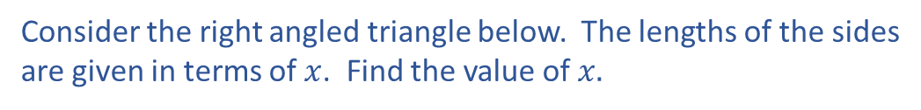

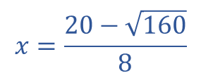



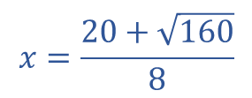
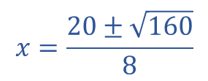





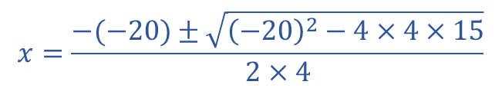


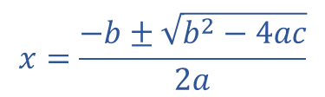
Consider the right angled triangle below. The lengths of the sides
are given in terms of $x$. Find the value of $x.$
$$3x−5$$
$$ax^{2}+bx+c=0$$
c
$$x+1$$
a
$$4x^{2}−20x+15=0$$
$$a=4 b=−20 c=15$$
Click here
for audio
b
$$x=\frac{−b±\sqrt{b^{2}−4ac}}{2a}$$
$$2x−3$$
$$a^{2}+b^{2}=c^{2}$$
Pythagoras
$$x=\frac{−(−20)±\sqrt{{\left(−20\right)}^{2}−4×4×15}}{2×4}$$
$${{\left(x+1\right)}^{2}{ + \left(2x−3\right)}^{2}=\left(3x−5\right)}^{2}$$
$$x=\frac{20±\sqrt{160}}{8}$$
$$\left(x+1\right)\left(x+1\right)+\left(2x−3\right)\left(2x−3\right)=(3x−5)(3x−5)$$
$$x^{2}+2x+1+4x^{2}−12x+9=9x^{2}−30x+25$$
$$x=\frac{20+\sqrt{160}}{8}$$
$$x=\frac{20−\sqrt{160}}{8}$$
$$5x^{2}−10x+10=9x^{2}−30x+25$$
$$x=4.08$$
or
$x=0$.92
$$4x^{2}−20x+15=0$$
Now solve this using
the quadratic formula
We can’t have the solution $x=0.92$ because$2x−3$ and
$3x−5$would be negative and you can’t have a negative length.

Slide 3


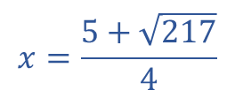



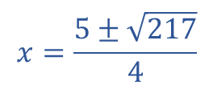
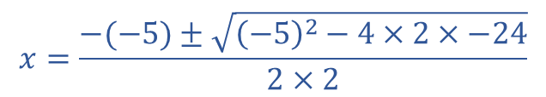




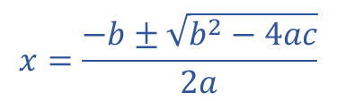


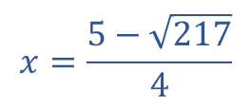


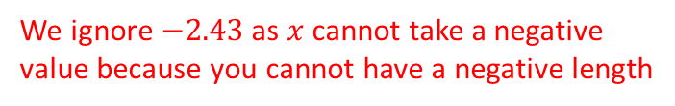
The rectangle below has a base of $2x−3,$ a height of $x−4$ and an area of 12${cm}^{2}$.
Find the value of $x.$
$$ax^{2}+bx+c=0$$
$$2x^{2}−5x−24=0$$
$$a=2 b=−5 c=−24$$
$$Area=12{cm}^{2}$$
$$x−4$$
$$x=\frac{−b±\sqrt{b^{2}−4ac}}{2a}$$
$$2x+3$$
Click here
for audio
$$x=\frac{−(−5)±\sqrt{{\left(−5\right)}^{2}−4×2×−24}}{2×2}$$
$$Area=\left(2x+3\right)\left(x−4\right)$$
$$\left(2x+3\right)\left(x−4\right)=12$$
$$x=\frac{5±\sqrt{217}}{4}$$
$${2x}^{2}−8x+3x−12=12$$
$$x=\frac{5+\sqrt{217}}{4}$$
$$x=\frac{5−\sqrt{217}}{4}$$
$$2x^{2}−5x−12=12$$
$$x=4.93 cm$$
or
$$x=−2.43$$
$$2x^{2}−5x−24=0$$
Now solve this using
the quadratic formula
We ignore $−2.43$ as $x$ cannot take a negative
value because you cannot have a negative length

Slide 4






$$x=\frac{5±\sqrt{7}}{6}$$
A quadratic equation has solutions
. Find the equation, in it’s simplest
form, which has these solutions.
$$x=\frac{5±\sqrt{7}}{6}$$
First $×$ by 6
OK lets start
$$6x=5±\sqrt{7}$$
Now square both sides
$$12x^{2}={(5±\sqrt{7})}^{2}$$
$12x^{2}=(5±\sqrt{7})(5±\sqrt{7}$)
Now expand the brackets
This doesn’t look its going anywhere useful
Next slide
Click here
for audio

Slide 5







$$x=\frac{5±\sqrt{7}}{6}$$
A quadratic equation has solutions
. Find the equation, in it’s simplest
form, which has these solutions.
$$x=\frac{5±\sqrt{7}}{6}$$
Click here
for audio
First $×$ by 6.
$$6x=5±\sqrt{7}$$
Now take 5 from both sides.
$$6x−5=±\sqrt{7}$$
Now square both sides. You lose the $±$ to just get 7.
$${(6x−5)}^{2} =7$$
Now expand the brackets.
$$\left(6x−5\right)\left(6x−5\right)=7$$
$$36x^{2}−60x+25=7$$
Now take 7 from both sides.
$$36x^{2}−60x+18=0$$
Now divide both sides by 6 to get the equation in it’s simplest form.
$$6x^{2}−10x+3=0$$
Try solving this. You will get back to the solutions we began with.

