Slide 1

Trigonometry
Finding any side or angle of a right angled triangle
Click here
for audio

Slide 2
First you need to check your calculator is set to degrees
Look at the top of the calculator display, you should see a . If so all is fine.
If you don’t, you’ll see either an or a . You need to see for degrees.
Here are some instructions to get your calculator onto degrees.
D
R
G
D
Press the following buttons on your calculator
Click here
for audio
Shift
Menu setup
1 : Input/Output
You will see 2 : Angle Unit. Press
2
You will see 1 : Degree Press
1
3 : Number Format
2 : Radian
4 : Engineer Symbol
3 : Gradian
Now you should see a at the top of your calculator display
D

Slide 3







The Sine, Cosine and Tangent ratios (Sin, Cos and Tan)
H
This just summarises
the triangle and
Sin, Cos and Tan.
O
This explains what is meant
by finding the numerator.
Important you listen to this.
$$θ$$
A
$$Sinθ=\frac{Opposite}{Hypotenuse}$$
$$Cosθ=\frac{Adjacent}{Hypotenuse}$$
$$Tanθ=\frac{Opposite}{Adjacent}$$
$$Sinθ=\frac{O}{H}$$
$$Cosθ=\frac{A}{H}$$
$$Tanθ=\frac{O}{A}$$

Slide 4
Reminder of how to find an angle
Click here
for audio

Slide 5
Find angle QPR (P)
Write out SOH CAH TOA and tick off
6.1cm
6.1cm
H
P
R
R
P
SOH CAH TOA
$$θ$$
5.4cm
5.4cm
O
We have A and H so tick the As and Hs
A
We want the one that has A and H
So we are going to use Cosine
Q
Q
$$Cosθ=\frac{A}{H}$$
Click here
for audio
$$Cosθ=\frac{5.4}{6.1}$$
now type
$$Cosθ=0.8852$$
Now type shift
Cos
Ans
=
5
.
4
$$×$$
6
.
1
$$=$$
shift
Cos
Ans
$$=$$
$$÷$$
$$θ=27.7$$

Slide 6
Reminder of how to find a side
Click here
for audio

Slide 7









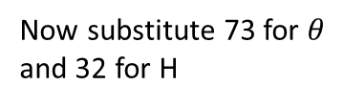

Side numerator
Write out SOH CAH TOA and tick off the side
we know and the one we are trying to find. So
here, O and H.
Find the side length $x.$
SOH CAH TOA
32cm
We want the one that has O and H
32cm
H
O
So we are going to use Sine
$$x$$
$$x$$
$$Sinθ=\frac{O}{H}$$
Now substitute 73 for $θ$
and 32 for H
73
73
A
$$Sin73=\frac{O}{32}$$
Now multiply by 32
Click here
for audio
now type
$$O=32×Sin73$$
Now type this into
Your calculator
3
2
$$×$$
3
$$×$$
Sin
7
858
$$=$$
$$x=30.6 cm$$

Slide 8


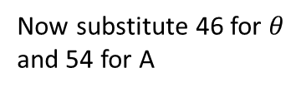


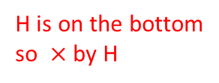

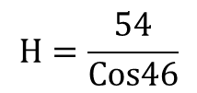
Side denominator
Write out SOH CAH TOA and tick off the side
we know and the one we are trying to find. So
here, A and H.
Find the length of side KL
M
54cm
M
54cm
A
L
L
46
46
SOH CAH TOA
O
H
So we are going to use Cosine
$$x$$
$$Cosθ=\frac{A}{H}$$
Now substitute 46 for $θ$
and 54 for A
K
K
$$Cos46=\frac{54}{H}$$
H is on the bottom
so $×$ by H
$$H×Cos46=54$$
Now divide by Cos46
Click here
for audio
$$H=\frac{54}{Cos46}$$
type
Now type this into
your calculator. You
can use the fraction
button if you like
5
4
$$×$$
6
$$÷$$
Cos
4
858
$$=$$
$$x=77.7 cm$$

Slide 9
Summary for finding a side
Click here
for audio

Slide 10


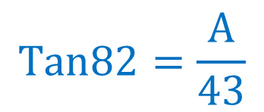
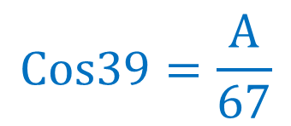

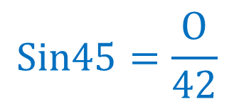
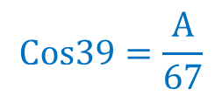
For these problems you will be finding
the side which is on top
$$Sin45=\frac{O}{42}$$
$$Cos39=\frac{A}{67}$$
$$Tan82=\frac{A}{43}$$
$$Cos39=\frac{A}{67}$$
$×$ by 67
For example
$$A=67×Cos39$$
Click here
for audio
$$A=52.1 cm$$

Slide 11
$$Cos38=\frac{14}{H}$$
For example
First you $×$ by H
So here there
are two steps
$$H×Cos38=14$$
Second you $÷Cos38$
$$H=\frac{14}{Cos38}$$
Click here
for audio
$$H=17.8cm$$
$$Sin24=\frac{74}{H}$$
$$Cos38=\frac{14}{H}$$
$$Tan34=\frac{23}{A}$$
For these problems you will be finding
the side which is on bottom

Slide 12
Summary for finding a side – two possible methods
$x$ is on the top (numerator)
$x$ is on the bottom (denominator)
One step
Two steps
$$Sin34=\frac{x}{23}$$
One step $×$ by $23$
$$Sin34=\frac{23}{x}$$
1st step $×$ by $x$
$$x=23×Sin34$$
$$x×Sin34=23$$
2nd step $÷Sin34$
$$x=\frac{23}{Sin34}$$
$$x=12.9 cm$$
Click here
for audio
$$x=41.1 cm$$

